Slide 1
بسم الله الرحمن الرحيم

Slide 2
Dark Room 4
Radiographic Films
Dr. Ahmad Mokhtar Abodahab – MD
Lecturer of radiology – Faculty of Medicine
Sohag University

Slide 3
Historical View
1889 William Rontgen discover X ray
Glass was the main material of films till W.W.II
Then cellulose nitrate
Until become of current shape

Slide 4
X ray Film Layers
7 Layers
2 main components :
Base قاعدة ”المادة الاساسية ”
Emulsion المادة الحساسة
2 other components :
Adhesive material
Super coating layer

Slide 5
Diagram of film component :
Notes:
A

Slide 6
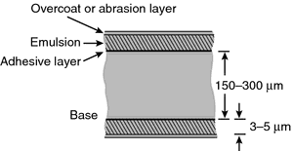
1
2
2
3
3
4
4

Slide 7
1- Base
Transparent
Light blue ←مريح للعين
Flexible
Fixed Dimensions
non inflammable
Water proof “

Slide 8
2- Sensitive emulsion
Silver Iodide - Silver bromide
Sensitive material , when exposed to light & Xray → Form image .
On both sides of Film
Fixed by adherent layer
Protected by protective layer

Slide 9
K
Br
+
Ag
No3
Ag
Br
K
No3

Slide 10
Sensitive material Grains
Fine grains حبيبات رقيقة
Larger grains حبيبات سميكة
According to temperature & mix velocity
Rapid mixing & low temp.→ Fine grains
Slow mixing & high temp.→ Larger grains.

Slide 12
Sensitive material is composed of
AgBr 90 : 99 %
AgI. 10 : 1 %
➔WHY ?
Mix is more sensitive .

Slide 13
Difference between Fine & coarse Grains?
More mix → More film sensitivity.
Use of one type → less sensitivity .

Slide 14
How to deal with X ray
Film boxes
inside plastic bags
water proof
Light proof

Slide 16
Film Storing :
sensitivity lost by time
Good storing = longer life
Avoid harmful factors , which are

Slide 17
Avoid exposing stored films to :
Light
Radiation
Temperature
Weight
.

Slide 18
Ideal Storage Factors :
Temp < 20 c
Humidity 50 : 60 , cool & dry
Away from any source of radiation
Boxes in vertical manner
Clear visualized expire date

Slide 19
Size of Films
➔In cm :
13 x 18 x 24 x 30 x 40 cm
35 X 35 X 43
➔In inches :
8 x 10 x 12 x 15
14 X 14 x 17

Slide 21
Data must be on Film
Name of Dr of Hospital
Patient name & number
Examination date
Site & type of exam
Timing of sequence scan eg, IVU

Slide 22
Sohag University Hospital
973- Mr. / Mrs. (Patient Name)
Date : 6 Oct 2021
IVU – 10 min

Slide 23
According to Sensitivity :
Blue Sensitive Films
Green Sensitive Films
Panchromatic Films
According to Screens Used :
Non Screen Films
(Direct Exposure ..as dental)
Screen Films :
Single Screen
Double Screen
According to Coating :
Single Emulsion
Double Emulsion

Slide 24
X ray Films Types
Screen Films
Non screen Films

Slide 25
1- افـــلام تستخدم مع اللوحــات المقــوية Screen Films
Sensitive for light & X ray
2 Types
Manual & Automatic Processing
Rapid Automatic

Slide 26
افـــلام تستخدم بدون اللوحــات المقــوية Non screen Films
Sensitive for X ray only
Manual & Automatic Processing
More Thick sensitive layer
Need more fixation time
More detailed image → used in mammography & bone imaging

Slide 27
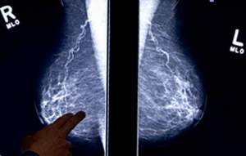
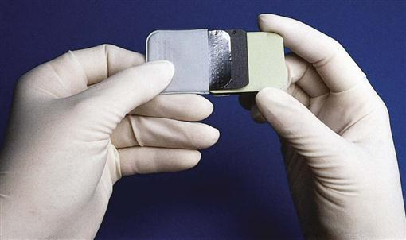
Special Types of X ray films
Practically The most important
Mammography Films
Dental radiography Films

Slide 28
Mammography Films
For breast imaging
One side covered by sensitive layer.
Very fine grains → More detailed image
With out intens. Screens
18x24 & 24x30 cm
Manual or automatic processing

Slide 29
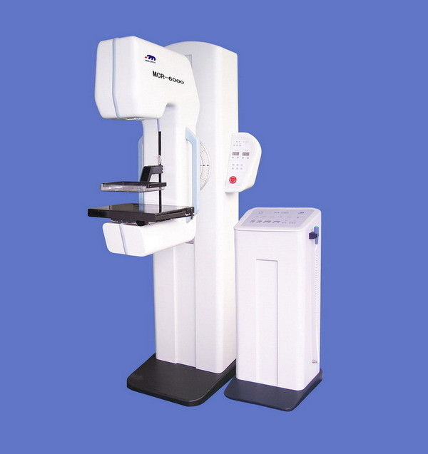
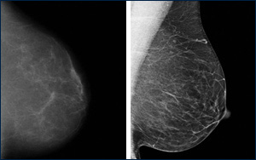

Slide 30
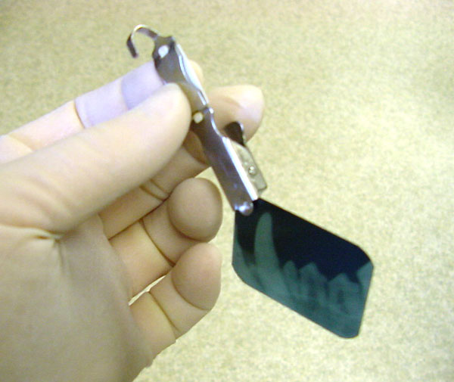
افلام الاسنان Dental Films
Very small sized
Used with its cover

Slide 31
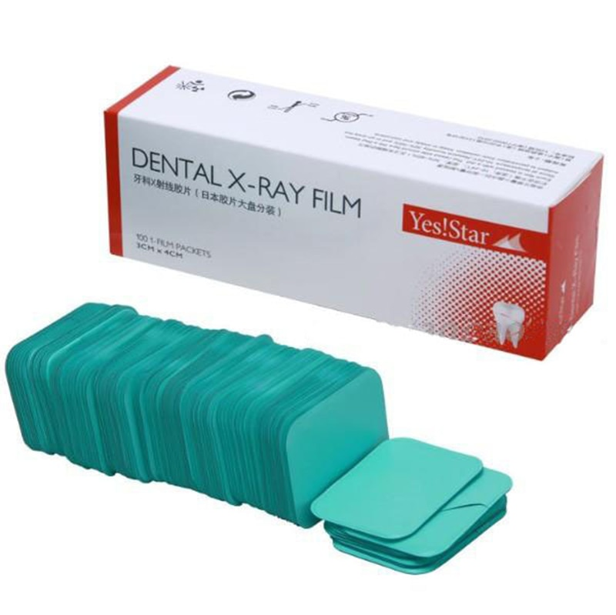
New Types of Dental Films
Processing Fluids are located with in a separate bucket with the film.
After exposure , squeezed → mix with film → image processing

Slide 32
We discussed Films used in Dark room
….. But many Other types of films are present , as :
Laser Prints Films

Slide 33
Further Reading & Sources :
https://radiopaedia.org/articles/x-ray-film
https://www.nde-ed.org/NDETechniques/Radiography/EquipmentMaterials/isotopesources.xhtml

Slide 34
Next Session
Intensfying screens

Slide 35
THANK YOU
Dr. Ahmad Mokhtar Abodahab Nov 2021

